Slide 1
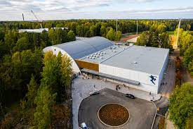
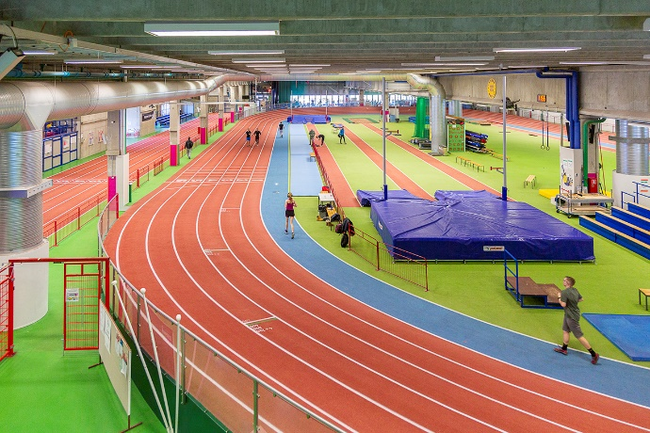
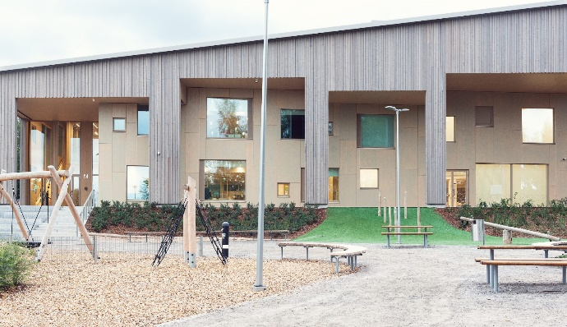
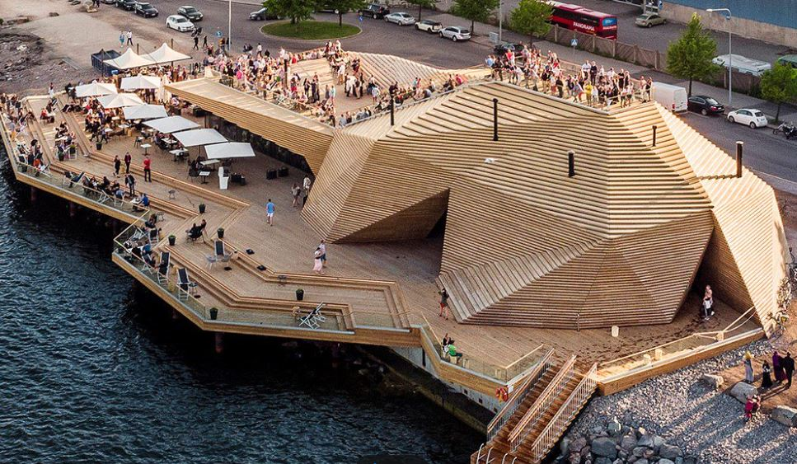
PIRKKOLA ICE-HALL RINK The new skating rink utilizes construction engineering that allows for the recycling of carbon dioxide in the pipes of the rink. This technology enables up to 60 per cent better energy efficiency compared to the old rink. In addition to this, a heat recovery pump has been connected to the rink’s refrigeration system to utilize the waste heat of the building. According to current estimates, the building will be able to operate on internal waste energy throughout the year, with the exception of winter periods when the outside temperature is extremely low.
LIIKUNTAMYLLY Then: The building was originally built in 1979 as the printing house of the Paragon press which worked at the premises until the 1990s. The building was designed from 1975 to 1979 by professor of architecture Aarno Ruusuvuori, who was known for using concrete as an architectural element. The building has later been protected in the zoning plan. After the building had been vacated during the early 1990s depression in Finland, the city of Helsinki bought the building and renovated it into an exercise hall from 1999 to 2000.
Now: Liikuntamylly serves exercise enthusiasts, active families and top athletes, and is a national indoor training center for athletics. In addition to the extensive athletics area, Liikuntamylly has facilities for budo and martial arts, climbing, wrestling, table tennis, floorball, badminton, dance, basketball and volleyball, as well as gyms.
THE MARTTA WENDELIN DAYCARE CENTER Facing south at the plot’s northern end, the somewhat elongated building shields the courtyard from traffic noise and emissions. Architecturally, the exteriors have been drawn with intentionally broad strokes. Wide canopy zones provide a backdrop for play activities in the yard, while the interiors form groups of general-purpose facilities designed for small groups of children. In between these two sections lies the heart of the building, which has an open layout with a variety of spaces, including a hall suitable for evening use, canteen areas, auxiliary facilities, and spaces for small groups.
Measured in cubic metres, the Martta Wendelin daycare centre is the largest of its kind built from solid wood in Finland.
LÖYLY Sauna bathing is an essential part of Finnish culture and national identity. There are only 5,4 million Finns but 3,3 million saunas. Public saunas used to be common in bigger cities but now that most new apartments have sauna of their own, public saunas have decreased dramatically in number.
As a sense of community is becoming a more and more important part of new urban culture, many new public saunas are being planned. With Löyly (meaning the steam that comes when you throw water on hot stones in a sauna) Helsinki will offer foreign visitors a public sauna experience all year round – a must when visiting Finland.

